Slide 1

Sheet 2 : Memory accesses
And some string manipulations

Slide 2
Question 1
Write a program that adds the following two multiword numbers and save the result using one-word transfer at a time:
DATA1=5463F8A8D37EH
And
DATA2=87DE340892C2H
How many bytes/words are each?
How big will the result of adding them be?

Slide 3
Question 1 - Background
If you add:
9 + 1 in decimal, you get 10
QUIZ: Can you think of two 1-digit numbers that can sum up to a 3-digits number?
The result of adding/subtracting two numbers has a max size of 1 digit bigger than the bigger number of the two.
By “size” we mean the number of digits.
Don’t waste your time

Slide 4
Question 1
DATA1=54 63 F8 A8 D3 7EH
DATA2=87 DE 34 08 92 C2H
Carry 1
DB
DC
54
63
F8
A8
D3
7E
87
DE
34
08
92
C2
Carry 1
41
42
DI
SI
2C
Carry 1
B1
DI
B0
SI
Carry 1
66
65
DI
40
SI

Slide 5
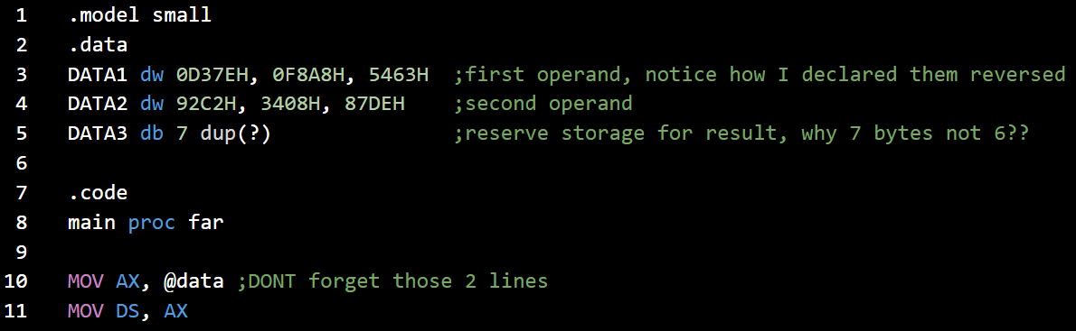
Question 1

Slide 6
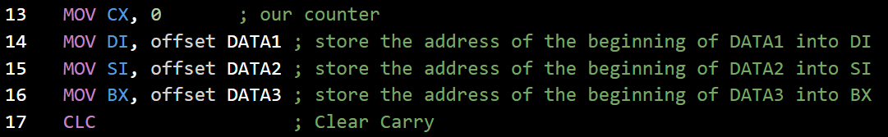
Question 1

Slide 7
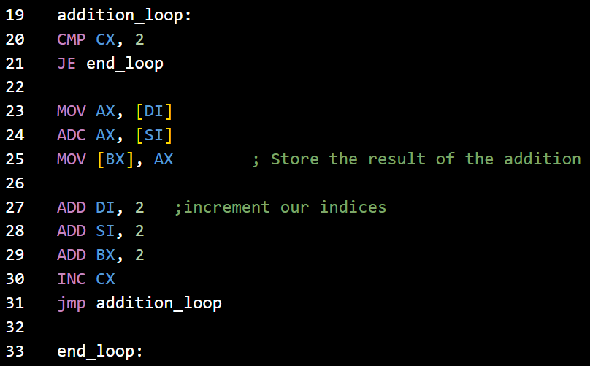
Question 1
Are we done yet?!?
NO

Slide 8
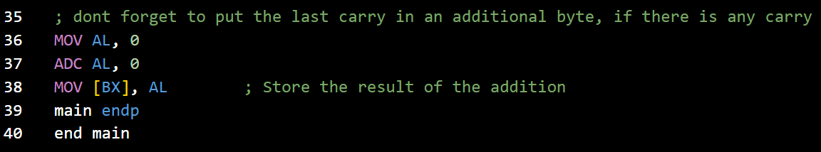
Question 1

Slide 9
Question 2
2. Repeat the previous program to subtract the two multiword numbers and save the result. Subtraction should be done a byte at a time.
DATA1=5463F8A8D37EH
And
DATA2=87DE340892C2H
Your turn now,
Grab a paper (or your laptop) and implement this program! 😴

Slide 10
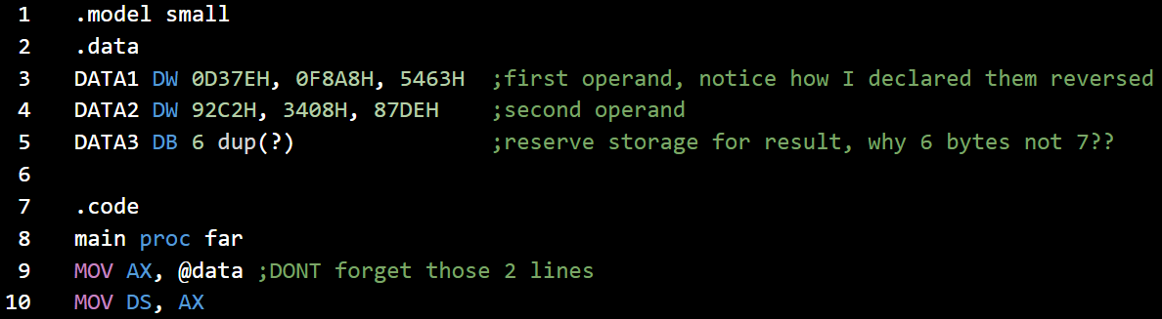
Question 2

Slide 11
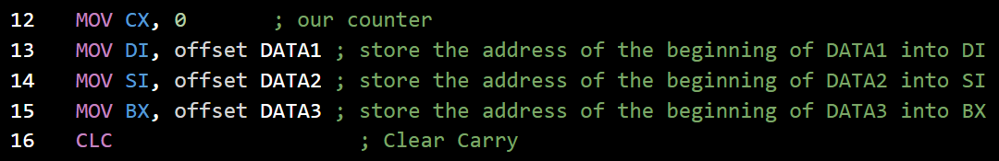
Question 2
Same as previous Question

Slide 12
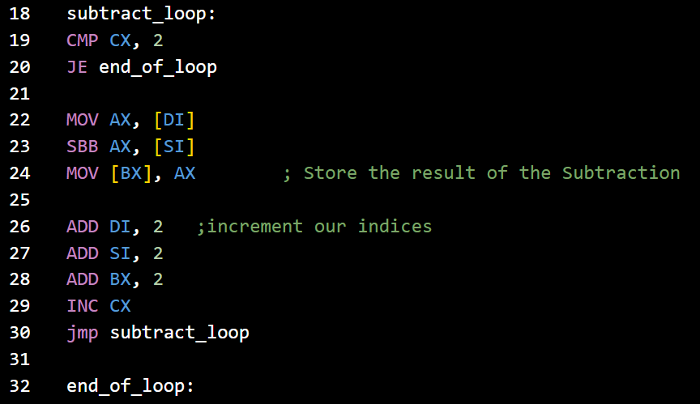
Question 2
Are we done yet?!?
YES 💀

Slide 13
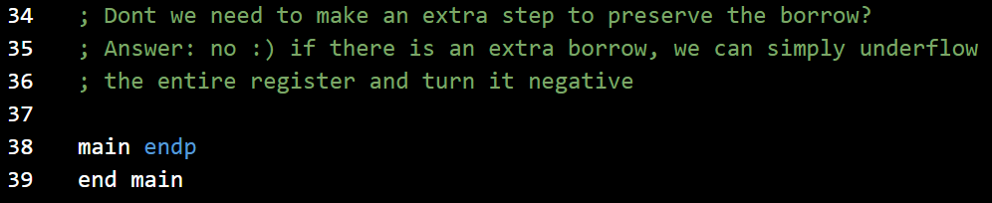
Question 2
This is true for single-word operations only.
But for multiword operations like this question, only the most significant word will be negated, so you need to turn all words to their 1’s complement, and the Least significant word to its 2’s complement

Slide 14
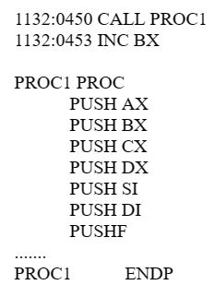
Question 3
In some applications it is a common practice to save all registers at the beginning of a subroutine.
Assume that SP = 1288H before a subroutine CALL.
For the following code:
Show the contents of the stack pointer and the exact stack contents after PUSHF

Slide 15
Question 3
Stack
Stack cont.
SI (Lower)
SI (Higher)
DH
DL
SP = 1288H

Slide 16
Question 3
Stack
Stack cont.
53
04
SI (Lower)
SI (Higher)
DH
DL
SP = 1286H

Slide 17
Question 3
Stack
Stack cont.
AL
AH
53
04
SI (Lower)
SI (Higher)
DH
DL
SP = 1284H

Slide 18
Question 3
Stack
Stack cont.
BL
BH
AL
AH
53
04
SI (Lower)
SI (Higher)
DH
DL
SP = 1282H

Slide 19
Question 3
Stack
Stack cont.
CL
CH
BL
BH
AL
AH
53
04
SI (Lower)
SI (Higher)
DH
DL
SP = 1280H

Slide 20
Question 3
Stack
Stack cont.
CL
CH
BL
BH
AL
AH
53
04
SI (Lower)
SI (Higher)
DH
DL
SP = 127EH

Slide 21
Question 3
Stack
Stack cont.
CL
CH
BL
BH
AL
AH
53
04
SI (Lower)
SI (Higher)
DH
DL
SP = 127CH

Slide 22
Question 3
Stack
Stack cont.
CL
CH
BL
BH
AL
AH
53
04
FLAGS (Lower Byte)
FLAGS (Higher Byte)
DI (Lower)
DI (Higher)
SI (Lower)
SI (Higher)
DH
DL
SP = 127AH

Slide 23
Question 3
Stack
Stack cont.
SP = 1278H
CL
CH
BL
BH
AL
AH
53
04
FLAGS (Lower Byte)
FLAGS (Higher Byte)
DI (Lower)
DI (Higher)
SI (Lower)
SI (Higher)
DH
DL

Slide 24
Question 3
Stack
SP = 1288H

Slide 25
Question 3
Stack
AX
SP = 1286H

Slide 26
Question 3
Stack
BX
AX
SP = 1284H

Slide 27
Question 3
Stack
CX
BX
AX
SP = 1282H

Slide 28
Question 3
Stack
DX
CX
BX
AX
SP = 1280H

Slide 29
Question 3
Stack
SI
DX
CX
BX
AX
SP = 127EH

Slide 30
Question 3
Stack
SP = 127CH
DI
SI
DX
CX
BX
AX

Slide 31
Question 3
Stack
SP = 127CH
FR
DI
SI
DX
CX
BX
AX

Slide 32
Question 3
B)
To restore the original information inside the CPU at the end of a CALL to a subroutine, the sequence of POP instructions must follow a certain order.
Write the sequence of POP instructions that will restore the information.
At each point, show the contents of SP.

Slide 33
Question 3
Stack
Stack cont.
SP = 1278H
CL
CH
BL
BH
AL
AH
53
04
FLAGS (Lower Byte)
FLAGS (Higher Byte)
DI (Lower)
DI (Higher)
SI (Lower)
SI (Higher)
DH
DL
Just POP in reversed order…
POPF
POP DI
POP SI
POP DX
POP CX
POP BX
POP AX
RET

Slide 34
Question 3
Stack
Stack cont.
CL
CH
BL
BH
AL
AH
50
04
FLAGS (Lower Byte)
FLAGS (Higher Byte)
DI (Lower)
DI (Higher)
SI (Lower)
SI (Higher)
DH
DL
Just POP in reversed order…
POPF
POP DI
POP SI
POP DX
POP CX
POP BX
POP AX
RET
SP = 1288H

Slide 35
Question 3
Stack
SP = 127CH
Just POP in reversed order…
POPF
POP DI
POP SI
POP DX
POP CX
POP BX
POP AX
FR
DI
SI
DX
CX
BX
AX

Slide 36
Question 3
Stack
Just POP in reversed order…
POPF
POP DI
POP SI
POP DX
POP CX
POP BX
POP AX
SP = 1288H

Slide 37
Question 3
C) Pushing all registers can be done in a single instruction, same applies for popping them.
What instructions are used to:
1- Push all Registers
2- Pop all Registers
PUSHA
POPA 🤷🏻‍♂️

Slide 38
Question 4
The following program contains some errors, fix the errors and make the program run correctly 😃
This program adds four words and saves the result

Slide 39
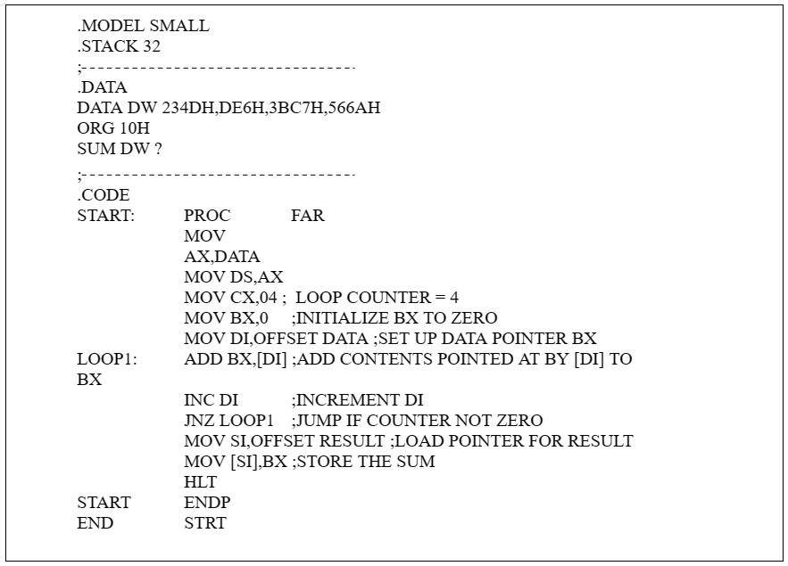

Slide 40
Can’t name a variable with “DATA” Rename it with “value1”
0DE6H
Remove “:” this is not a label
@DATA
Rename it with “value1”
Missing Loop counting:
DEC CX
This is adding a byte each iteration, it should be ADD DI, 2
Missing Comparison
CMP CX, 0
START, not STRT

Slide 41
Question 5
Find ZF, CF, AF for each of the following. Also indicate the result of addition and where the result is saved.
MOV BH, 3FH ADD BH, 45h | MOV BX, 0FF01H ADD BL, BH | MOV AH, 0FEH STC ADC AH, 00
MOV DX, 4599H MOV CX, 3458H ADD CX, DX | MOV AX, 255 STC ADC AX, 00 | MOV CX, 0FFFFH STC ADC CX, 00
ZF = 0 CF = 0 AF = 1
BH = 84h
ZF = 1 CF = 1 AF = 1
BL = 00
ZF = 0 CF = 0 AF = 0
AH = 0FFh
ZF = 0 CF = 0 AF = 1
CX = 79F1h
ZF = 0 CF = 0 AF = 1
AX = 0100h
ZF = 1 CF = 1 AF = 1
CX = 0000h

Slide 42
Question 6
Assume that the following registers contain these HEX contents:
AX = F000 BX = 3456 DX = E390
Perform the following operations. Indicate the result and where the result is saved
Also give CF and ZF in each case.
NOTE: each operation is independent of the other.

Slide 43
Question 6
AX = F000 BX = 3456 DX = E390
1111000000000000 AND
1110001110010000
= 1110000000000000 → DX
DX = E000h
ZF = 0
CF = 0
AND DX, AX
01110110 XOR
00000000
= 01110110 → AL
AL = 76h
ZF = 0
CF = 0
b) XOR AL, 76h

Slide 44
Question 6
AX = F000 BX = 3456 DX = E390
Setting AX to 0000
AX = 0000h
c) XOR AX, AX
ZF = 1
CF = 0
ANDing with 1s keeps everything in place.
AH = F0h
ZF = 0
CF = 0
d) AND AH, 0FFh

Slide 45
Question 6
AX = F000 BX = 3456 DX = E390
0000111011101110 AND
1110001110010000
= 1110110101111110 → DX
DX = ED7Eh
ZF = 0
CF = 0
e) XOR DX, 0EEEEh
AL was zero, shift it 4 places, it is still zero
AL = 00h
ZF = 1
CF = 0
f) MOV CL, 04h
SHL AL, CL

Slide 46
Question 6
AX = F000 BX = 3456 DX = E390
10010000 shifted 3 right
= 00010010 → DL
(same as division by 2^3)
DL = 12h
ZF = 0
CF = 0
g) MOV CL, 3
SHR DL, CL
10010000 shifted 6 left
= 00000000 → DL
DL = 00h
ZF = 0
CF = 1
h) MOV CL, 6
SHL DL, CL

Slide 47
Question 7
Indicate the status of ZF and CF after CMP is executed in each of the following cases:
MOV BX, 2500 CMP BX, 1400
SUB AX, AX CMP AX, 0000
MOV DL, 34 CMP DL, 88
MOV AL, 0FFh CMP AL, 6Fh
ZF = 0 CF = 0
ZF = 1 CF = 0
ZF = 0 CF = 1
ZF = 0 CF = 0

Slide 48
Question 7
Indicate the status of ZF and CF after CMP is executed in each of the following cases:
XOR DX, DX CMP DX, 0FFFFh
MOV BX, 2378h MOV DX, 4000h CMP DX, BX
SUB CX, CX DEC CX CMP CX, 0FFFFh
MOV AL, 0AAh AND AL, 55h CMP AL, 00
ZF = 1 CF = 0
ZF = 0 CF = 0
ZF = 1 CF = 1
ZF = 1 CF = 0
Notes:
AL = 1010 1010
1010 1010 AND
0101 0101
= 0000 0000

Slide 49
Question 8
Indicate whether or not the jump happens in each case:
MOV CL, 5 SUB AL, AL SHL AL, CL JNC TARGET | MOV BH, 65H MOV AL, 48H OR AL, BH SHL AL, 1 JC TARGET | MOV AH, 55H SUB DL, DL OR DL, AH MOV CL, AH AND CL, 0FH SHR DL, CL JNC TARGET

Slide 50
Question 8
MOV CL, 5 SUB AL, AL SHL AL, CL JNC TARGET
CL = 5
AL = 0, ZF = 1, CF = 0
Multiply AL by 2^5
Carry is zero
So we Jump if not carry
So we jump

Slide 51
Question 8
MOV BH, 65H MOV AL, 48H OR AL, BH SHL AL, 1 JC TARGET
BH = 65h
AL = 48h
01001000 OR
01100101
= 01101101 → AL
AL = 11011010, CF = 0
Carry is zero
And we Jump if carry == 1
So we don’t jump

Slide 52
Question 8
MOV AH, 55H SUB DL, DL OR DL, AH MOV CL, AH AND CL, 0FH SHR DL, CL JNC TARGET
AH = 55h
DL = 0, ZF = 1, CF = 0
DL = Ah = 55h by ORing with zero
CL = Ah = 55h
CL = 05h ie eliminate the upper nibble
01010101 SHR
5
= 00000010 → DL
CF = 1
Carry is 1
And we Jump if not carry
So we don’t jump

Slide 53
Question 9 REQUIREMENT
Write a program that converts all uppercase letters to lowercase.
.Data
InputString DB “THis iS A TEsT MESsaGE”
ResultString DB 22 DUP(?)
Notes:
We cannot write
MOV AL, “a” and expect that “a” will be converted into its ascii representation.
The correct way to load the ascii representation of a character is to store it in the data segment and then read it into a register.
Correct way:
.data
charA db “a”
.code
Mov AL, charA
Now AL contains the ascii representation of character A
NOTE: characters span 1 byte each. Not a word.
We can check if a character is capital or not by checking if its ascii representation is bigger than “A” or not.
If the letter is capital, just subtract 20h from it
“A” is 41h, while “a” is 61h

Slide 54
Question 10 REQUIREMENT
An instructor called Mr. Mo Allem has the following grading policy: “Curving of grades is achieved by adding to every grade the difference between 99 and the highest grade in the class”.
If the following are the grades of the class. Write a program to calculate the grades after they have been curved:
81, 65, 77, 82, 73, 55, 88, 78, 51, 91, 86, 76
Your program should work for any set of grades
Assume you know the number of students in the class.

Slide 55
Thank You
One day, all your hard work will pay off.

